Slide 1





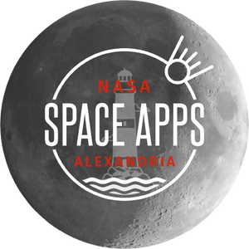




3
LESSONCOURSE
Planetary Recognition and Analysis Model
PRESENTING
ALEX AI TEAM

Slide 2

About Our Project
PRAM Model
is an AI-powered system developed by
Assem Sabry and his team Alex AI to classify and analyze exoplanet candidates using open NASA datasets. By combining stellar information, light curves, and planetary catalogs from missions such as Kepler and TESS, Astro Model predicts whether a signal represents a confirmed exoplanet, a candidate, or a false positive. This approach speeds up the discovery process, improves classification accuracy, and offers researchers and enthusiasts an easy-to-use interface to explore new worlds beyond our solar system.

Slide 3





The Problem We’re Solving in Exoplanet Detection
1
2
3
Identifying
True Exoplanets vs. False Positives
Classifying Exoplanet Types
Analyzing
Large NASA Datasets Efficiently

Slide 4

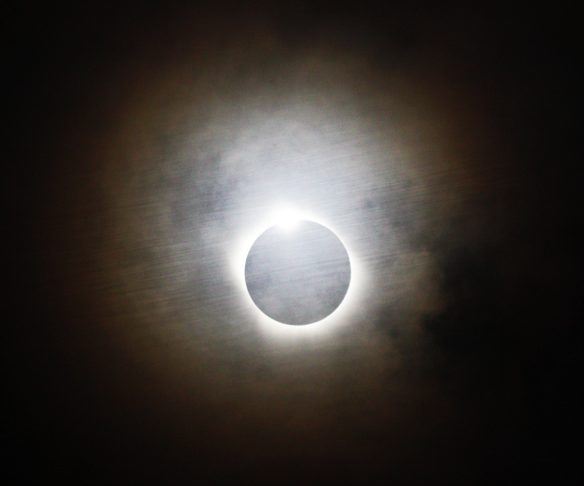
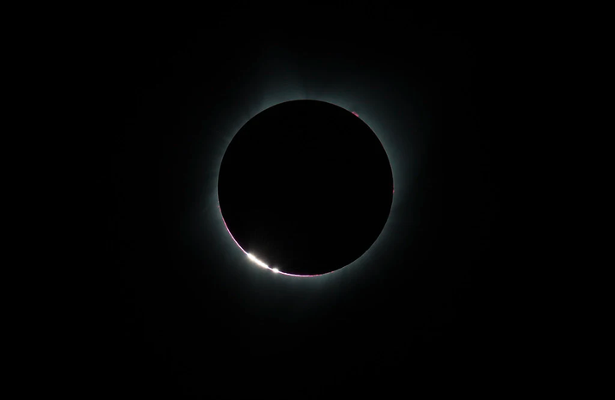

OUR SOLUTIONS
EXOPLANET CANDIDATE CLASSIFICATION
MULTI-MODEL ENSEMBLE PREDICTION
AUTOMATED FEATURE ENGINEERING FOR TRANSIT ANALYSIS
The model classifies incoming transit signals from space missions into real exoplanets or false positives.
It learns complex patterns in orbital period, depth, and stellar data to make its decision.
This feature reduces the need for manual vetting of thousands of candidates.
It also helps prioritize the most promising targets for follow-up observations.
By automating classification, the model speeds up exoplanet discovery and increases reliability.
The system combines four different algorithms — XGBoost, LightGBM, CatBoost, and a Neural Network.
Each model contributes its strengths to improve overall prediction stability.
This ensemble approach reduces overfitting and balances biases between models.
It produces more consistent probability scores than using a single model.
The result is higher accuracy and stronger confidence in predicted outcomes.
The model generates new features such as ratios, logarithmic values, and zone indicators from raw inputs.
These engineered features help the algorithms detect hidden patterns.
They provide richer information about planetary systems than raw numbers alone.
This process allows the model to distinguish subtle differences between planet types.
As a result, the detection and classification performance significantly improves.

Slide 5

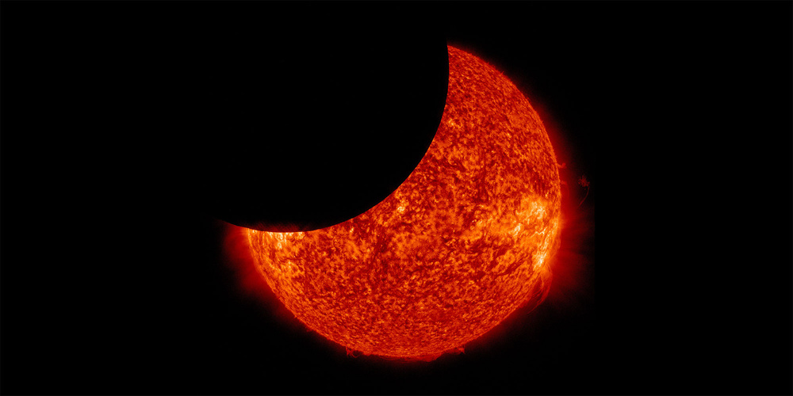

HOW OUR MODEL WORKS
Model Architecture
Our Enhanced Unified Exoplanet Detection Model combines multiple machine learning algorithms into a single ensemble to achieve highly accurate predictions. The model first preprocesses raw exoplanet and stellar data into engineered features, then scales the inputs and passes them through several advanced classifiers. Each classifier makes an independent prediction, and their results are combined into an ensemble output using an optimized threshold to maximize F1 score and overall performance.
HOW IT WORKS
Raw data from the three CSV files is transformed into the 27 features.
Features are scaled with the trained scaler.
Each model independently predicts the probability of a planet being real.
Probabilities are averaged into one ensemble score.
The ensemble score is compared to the threshold to decide final classification (confirmed vs. false positive).
Feature Engineering Layer
Multiple Classifiers
Scaler/Preprocessing Module

Slide 6
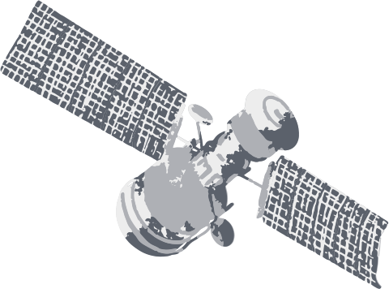
Contains information on potential exoplanets detected by NASA missions, including orbital period, transit depth, and planetary radius.
Exoplanet Candidates Dataset
Training Data
We used open-source exoplanet datasets provided by NASA and related space science repositories. These datasets include a wide range of stellar and planetary parameters — such as orbital periods, transit depths, temperatures, and host star properties — which were cleaned and engineered into features for training. By combining multiple datasets, our model gains a richer understanding of exoplanet characteristics and improves its prediction accuracy.
A dataset of confirmed exoplanets with more complete and validated parameters such as equilibrium temperature, insolation flux, and transit duration.
Confirmed Exoplanets Dataset
Includes properties of host stars such as stellar effective temperature, surface gravity, and stellar radius to better understand the planet–star system.
Stellar Parameters Dataset

Slide 7


Final Summary & Future Direction
Our team, Alex AI, developed an Enhanced Unified Exoplanet Detection Model with a future plan to integrate a full GUI for real-time analysis and visualization. This solution was designed to tackle NASA’s exoplanet classification challenge by leveraging multiple machine learning models in one ensemble. The model currently achieves an overall accuracy of about 96%, proving its high potential to identify true exoplanets. With the planned GUI, the model will become more user-friendly and practical for scientists and researchers.
ALEX AI TEAM

